Slide 1
JavaScript API: Tips and Tricks
Tableau Developer Video Series
JavaScript API

Slide 2
JavaScript API Video Series
JSAPI Introduction
JSAPI Tutorial
Companion Content: http://github.com/tableau/JSAPIVideos
Embedding & Interactions
Tips & Tricks

Slide 3
At the end of this video you will...
TODO #1
TODO #2
TODO #3
TODO #4

Slide 4
Understanding API Versions
Tableau Server version | JavaScript API .js files
8.0 | tableau_v8.js tableau_v8.debug.js
9.0 | tableau-2.0.0.min.js tableau-2.0.0.js
9.1 | tableau-2.min.js tableau-2.js
Source: http://onlinehelp.tableau.com/current/api/js_api/en-us/help.htm

Slide 5
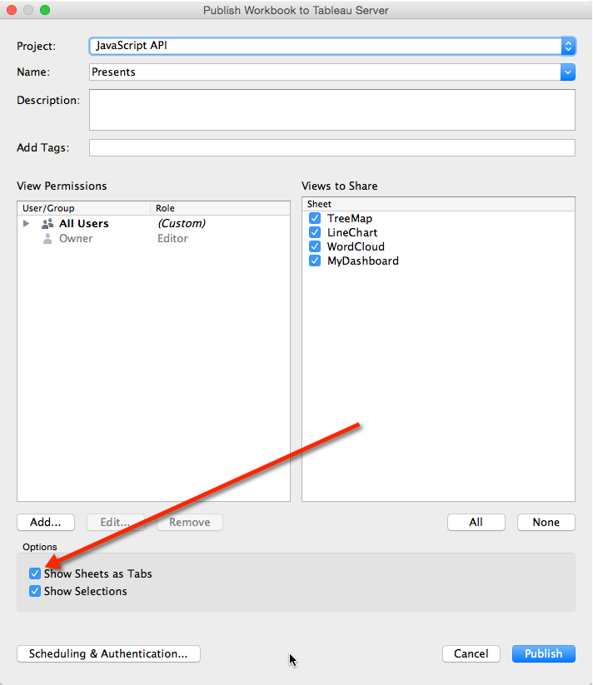

Slide 6
Handling Dashboards

Slide 7
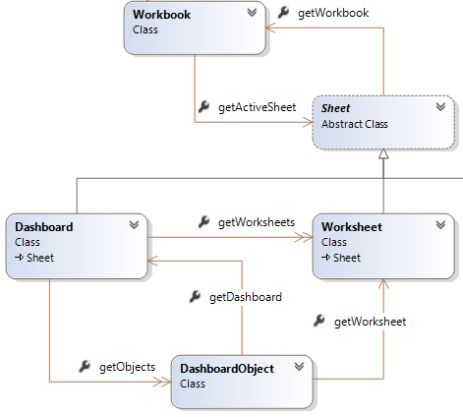
Handling Dashboards
Source: http://onlinehelp.tableau.com/current/api/js_api/en-us/help.htm

Slide 8
Asynchronous Programming
onFirstInteractive
Execute some code after the viz loads
.then()
Execute some code after a JSAPI function finishes

Slide 9
Event Listeners
Execute some code when the user does something:
Marks Selection
Tab Switch
Filter Change
Parameter Value Change
Story Point Switch
Custom View Interaction
Viz Resize

Slide 10
Developer Resources
Tableau Developer Portal (http://developers.tableau.com)
JavaScript API Developer Docs
Hands-on Introductory Tutorial
Community Forum
Other Videos: #DataDev YouTube
JS API Series Content (http://github.com/tableau/JSAPIVideos)
Notes:
The Tableau Developer Portal (http://developers.tableau.com) is the one-stop shop for everything related to APIs and extensibility. You can find links to the JSAPI docs, examples, a hands-on tutorial, and forums for discussing the JavaScript API.

